Slide 1

Extension Methods
Lecturer
Rokas Slaboševičius
Data

Slide 2
Today you will learn
Extension methods
What are extension methods?
01
This keyword
02
How to create extension methods
03

Slide 3
What are extension methods?
Extension methods
Extension methods allow you to "add" new functionality to an existing type.
Extension methods are static, but they are called as if they were instance methods on the type to be extended.

Slide 4
How are extension methods described?
Extension methods
Extension methods are described as static methods, but are called as instance methods (called through an object, not a class)
The first parameter of the extension method specifies the type of the method being written (e.g. this(next slide) string str)

Slide 5
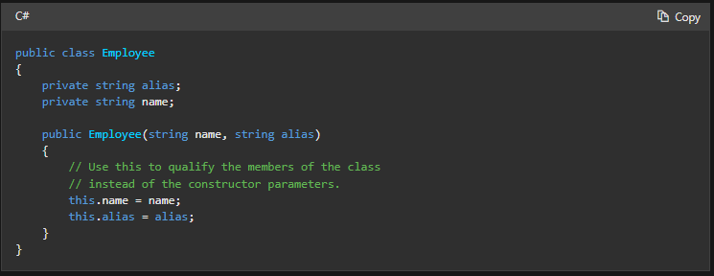
this keyword
Extension methods
The keyword this refers to the current instance of the class and also as a modifier for the first parameter to the extension method.
We will learn how it is used in extension modules, but for now here is an example of how it works in relation to a class instance.
Example:
Inside the constructor, calling the variable alias would call
variable is obtained via parameters, but to access the variable
which is part of a class, the variable name must be preceded by
"this"

Slide 6
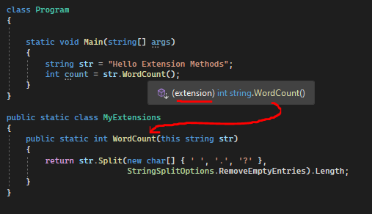
How are extension methods described?
Extension methods
This example shows how to describe the extension method for the class System.String:

Slide 7

Extension methods
Task 1
Write an extension method for integers that returns a variable of type bool indicating whether the number was positive or negative.
Write an extension method for integers that returns a variable of type bool indicating whether the number was even or not.
Write an extension method for integers that returns a variable of type bool indicating whether the number passed in the parameter is greater or not.
Write an extension method for the string type that will return a variable of type bool indicating whether a sentence contains spaces or not.
Write an extension method for a string type with the parameters fullname, yearOfBirth and domain, the method will return the result as an email address. For example: "vardenispavardenis1990@gmail.com"
Write an extension method FindAndReturnIfEqual for type List<T> that accepts an object of type T as a parameter and returns the same if it exists in the list.
Write an extension method EveryOtherWord for the List<T> type that returns a list consisting of every second element.
Would it be possible to create extension methods for the System.IO.File class? For example to create functionality that returns every second line from a text file.

Slide 8
Extension Methods
Extension methods
https://docs.microsoft.com/en-us/dotnet/csharp/programming-guide/classes-and-structs/extension-methods
https://www.tutorialsteacher.com/csharp/csharp-extension-method
Useful information

